Slide 1
Unit 210: Understand how to communicate with others within building services engineering
Communication methods

Slide 2
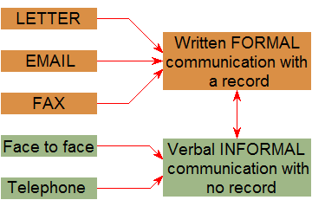
Communication methods
Written formal communication
Letters
Official method of communication, they can help towards a good image if written well.
Official company business should always be in a written form on company headed paper.
Sales, quotations, information, enquiries.

Slide 3
Communication methods
Written formal communication
Emails
The use of emails has increased dramatically over the past few years, due to its convenience and speed.

Slide 4
Communication methods
Written formal communication
Faxes
These can be used to convey copies of formal documents (invoices, quotations, contracts).
A cover page needs to be used with these.

Slide 5
Communication methods
Verbal informal communication
More often than not, the spoken word is our main method of communication.
We still have a responsibility to maintain the company image so listen carefully and be aware of:
what you are saying
tone of voice
body language
the response.
Verbal communication quite often needs to be backed up with written confirmation.

Slide 6
Unit 210: Understand how to communicate with others within building services engineering
The End

